Slide 1

Motivations to adopt a new approach
Main limitations of the old model (Pizzocri et al. 2023)
Linearization of the diffusion coefficient -> difficulty in capturing exponential behaviour far from the linearization temperature.
Train on a single set of parameters -> no possibility to generalized
Offline phase performed in OpenFOAM -> code sharing requires tool knowledge.
Improvements in the new approach:
Use of a well-established method from the literature instead of linearization for the diffusion coefficient.
Incorporation of multiple parameter sets for better generalization.
Perform offline phase in FreeFEM++ and Python.

Slide 2
Schematic representation

Slide 3
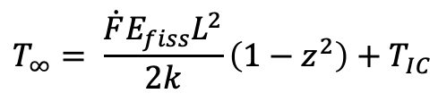
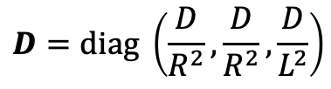
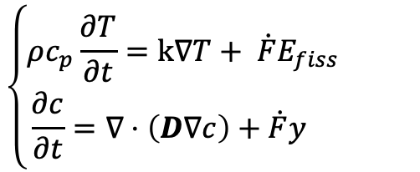


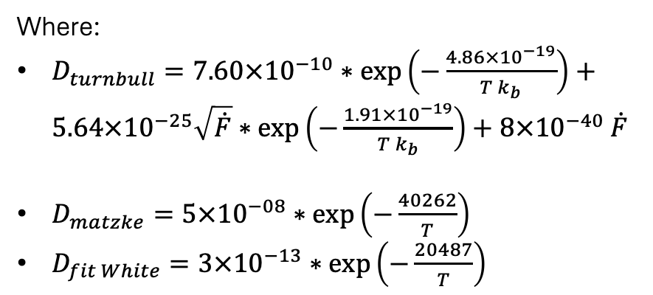
Governing equations
$$\left\{\begin{aligned}ρc_{p}\frac{∂T}{∂t}=k∇T+ \dot{F}E_{fiss} \\ \frac{∂c}{∂t}=∇⋅\left(D∇c\right)+\dot{F}y \end{aligned}\right.$$
$$c_{BC}=0, T_{BC}=T_{IC}, ∇T⋅n=0$$
$$c_{IC}=0$$
Where:
$D_{turnbull}=7.60×{10}^{−10}∗\exp\left(−\frac{4.86×{10}^{−19}}{T k_{b}}\right)+$ $5.64×{10}^{−25}\sqrt{\dot{F}}∗\exp\left(−\frac{1.91×{10}^{−19}}{T k_{b}}\right)+8×{10}^{−40}$ $\dot{F}$
$D_{matzke}=5×{10}^{−08}∗\exp\left(−\frac{40262}{T}\right)$
$D_{fit White}=3×{10}^{−13}∗\exp\left(−\frac{20487}{T}\right)$
$$D=diag \left(\frac{D}{R^{2}},\frac{D}{R^{2}},\frac{D}{L^{2}}\right)$$
From Pizzocri et al. 2023 the temperature field develops much more rapidly than the concentration field -> decouple the two PDEs and solve the steady state:
$$T_{∞}= \frac{\dot{F}E_{fiss}L^{2}}{2k}\left(1−z^{2}\right)+T_{IC}$$
solved 1D

Slide 4
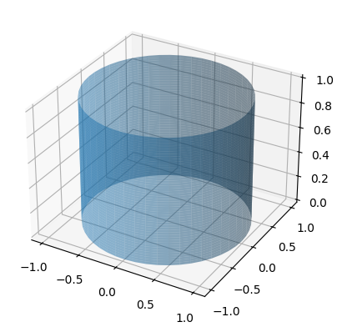
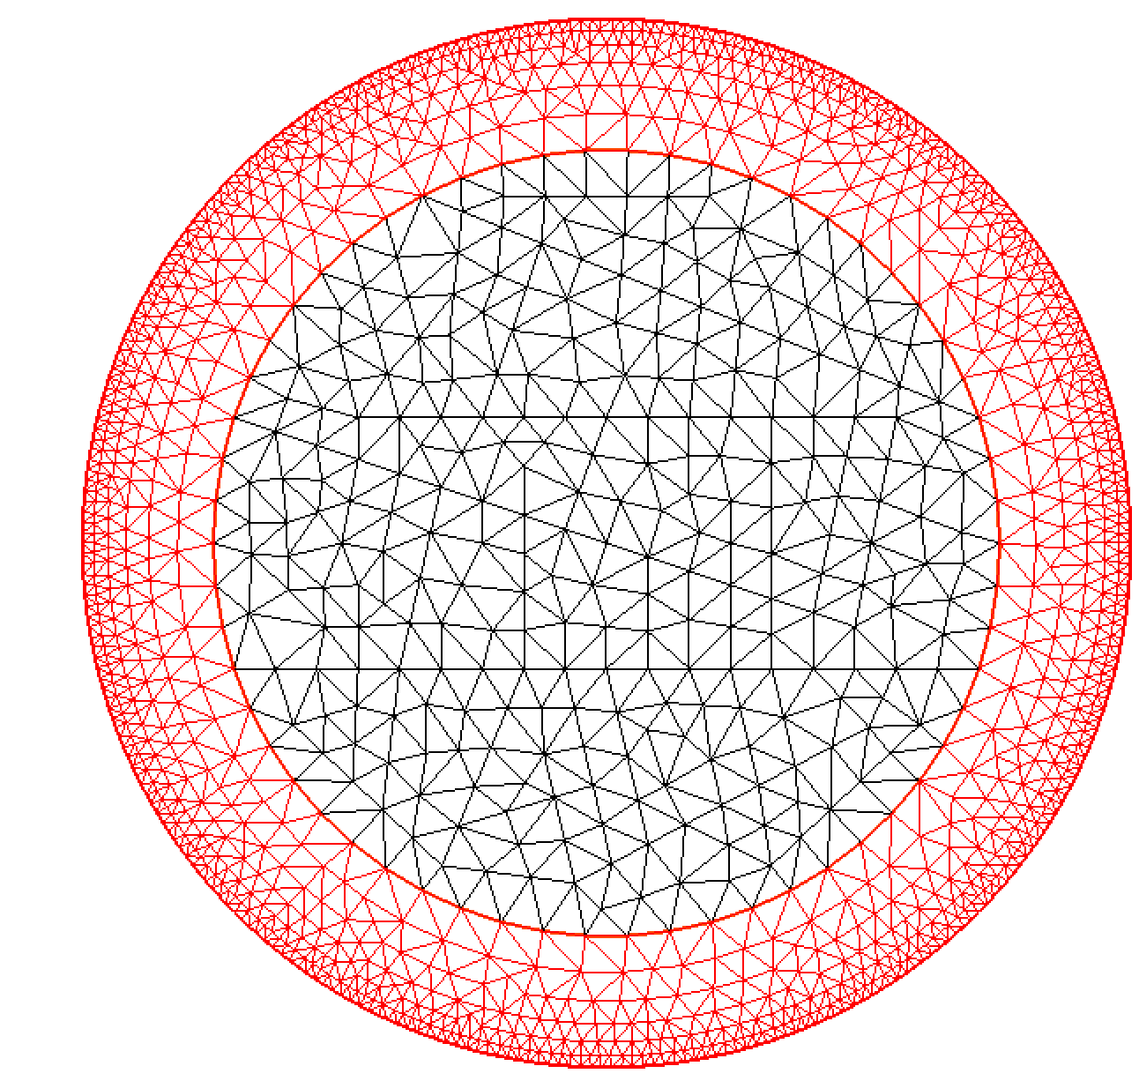
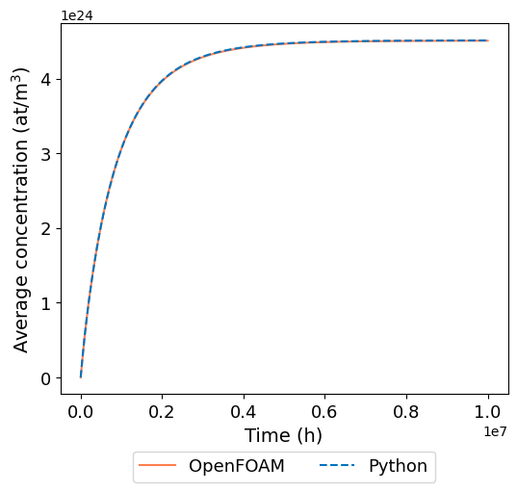
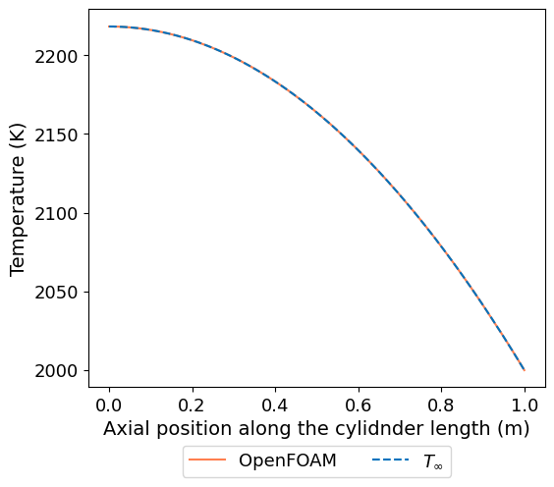
Full order model in FreeFEM++ and Python
Finite element modelling in FreeFEM++
Mesh sensitivity.
Comparison with the OpenFOAM solution:
Error at steady state = 0.08%
Max error = 0.017%

Slide 5
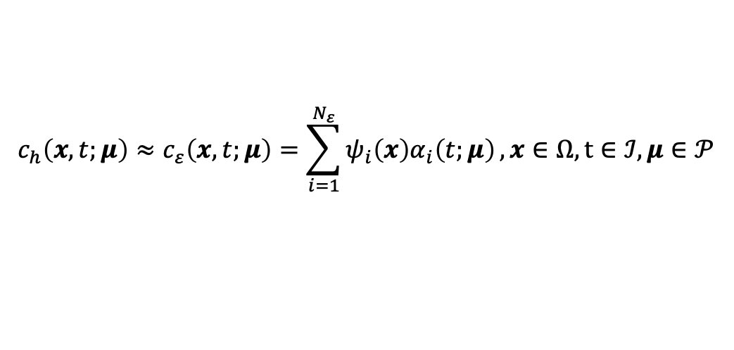

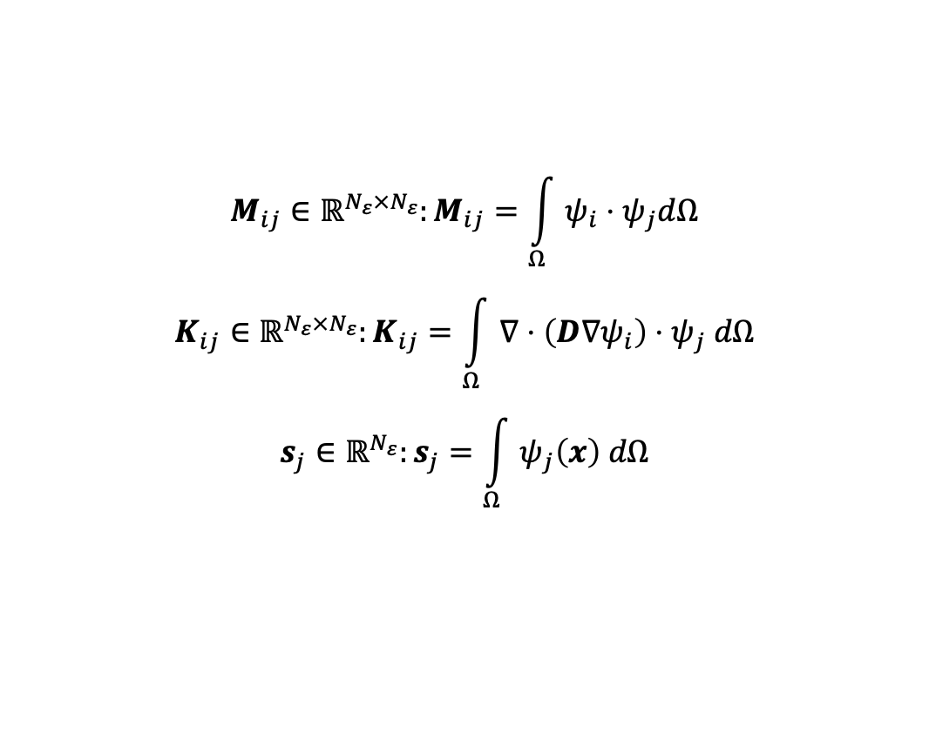
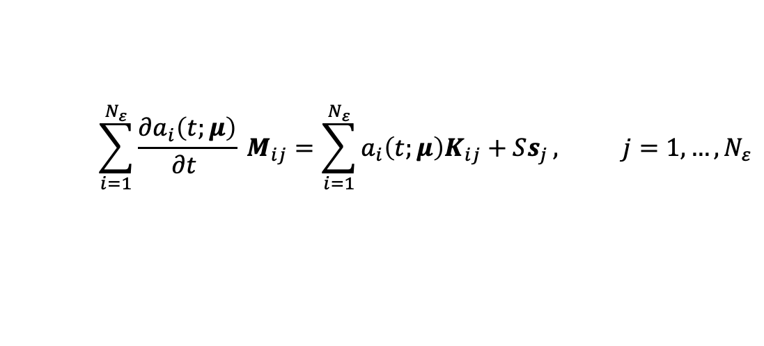
Reduced order model
Once the $N_{ε}$dimensional set of spatial reduced basis functions ${\left\{ψ_{i}\left(x\right)\right\}}_{i=1}^{N_{ε}}$the reduced space $𝒱_{ε}⊂𝒱_{h}⊂𝒰$ is constructed. The full model solution $c_{h}$ is approximated by:
$$c_{h}\left(x,t;μ\right)≈c_{ε}\left(x,t;μ\right)=\sum_{i=1}^{N_{ε}}{ψ_{i}\left(x\right)α_{i}\left(t;μ\right)},x∈Ω, t∈ℐ, μ∈𝒫$$
$$\sum_{i=1}^{N_{ε}}{\frac{∂a_{i}\left(t;μ\right)}{∂t }} M_{ij}=\sum_{i=1}^{N_{ε}}{a_{i}\left(t;μ\right)K_{ij}+Ss_{j}}, j=1, …,N_{ε}$$
Being $φ_{j}\left(x\right)$ the test functions:
$$M_{ij}∈ℝ^{N_{ε}×N_{ε}}:M_{ij}=\int_{Ω}{ψ_{i}⋅ψ_{j}dΩ}$$
$$K_{ij}∈ℝ^{N_{ε}×N_{ε}}:K_{ij}=\int_{Ω}{∇⋅\left(D∇ψ_{i}\right)⋅ψ_{j} dΩ}$$
$$s_{j}∈ℝ^{N_{ε}}:s_{j}=\int_{Ω}{ψ_{j}\left(x\right) dΩ}$$
Mass matrix
Stiffness matrix
Source vector

Slide 6
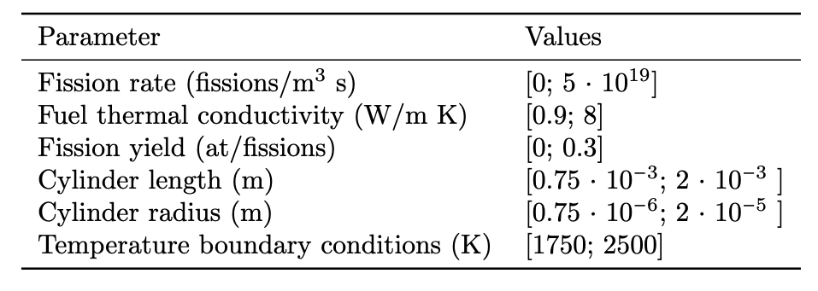
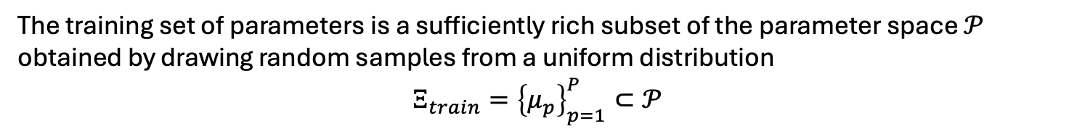
Reduced order model: training set
The training set of parameters is a sufficiently rich subset of the parameter space $𝒫$ obtained by drawing random samples from a uniform distribution
$$Ξ_{train}={\left\{μ_{p}\right\}}_{p=1}^{P}⊂𝒫$$
Values determined based on the SUPERFACT-1 (Luzzi et al., 2021; Luzzi et al., 2023) and SPHERE (Lainet et al., 2024) JOYO (Maeda et al., 2009) irradiation experiments.

Slide 7
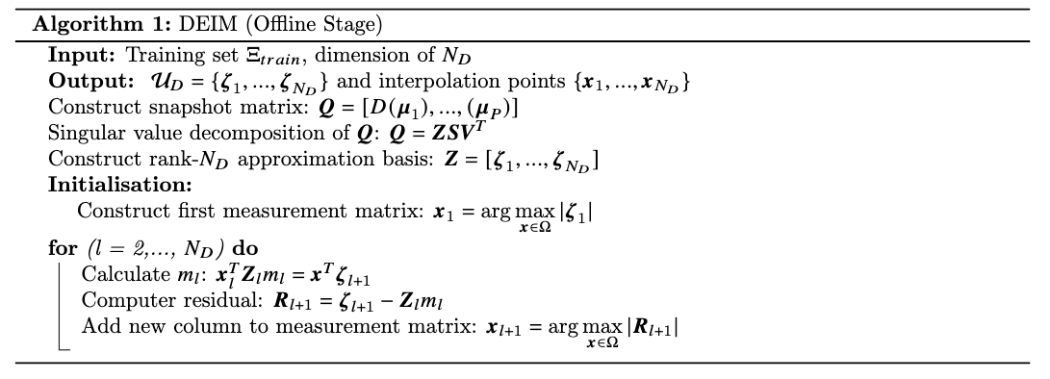
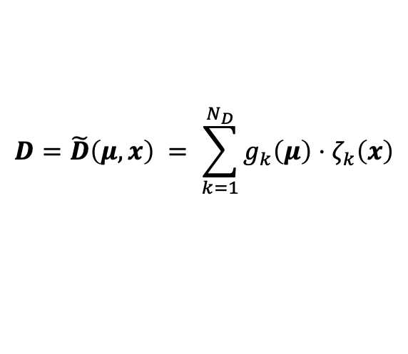

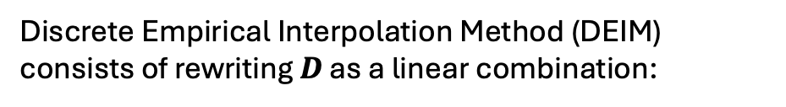

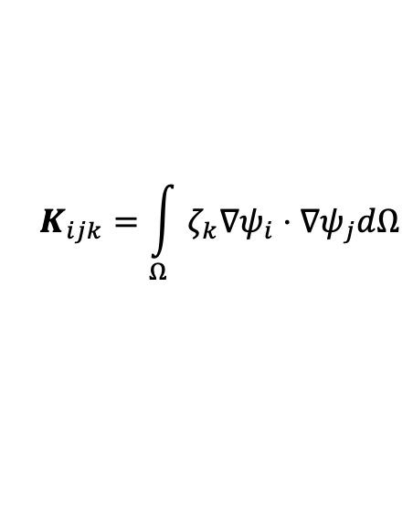
DEIM: construction of affine decomposition
Discrete Empirical Interpolation Method (DEIM) consists of rewriting $D$ as a linear combination:
$$N_{D}=7$$
$$D=\tilde{D}\left(μ, x\right) = \sum_{k=1}^{N_{D}}{g_{k}\left(μ\right)⋅ζ_{k}\left(x\right)}$$
computed during the online phase
The stiffness matrix is rewritten in this way:
$$K_{ijk}=\int_{Ω}{ζ_{k}∇ψ_{i}⋅∇ψ_{j}dΩ}$$
$$K_{ij,k}∈ℝ^{N_{D}×N_{ε}×N_{ε}}$$
Notes:
Con il DEIM decomponiamo affinamente la stiffness cosi da avere un problema lineare.

Slide 8
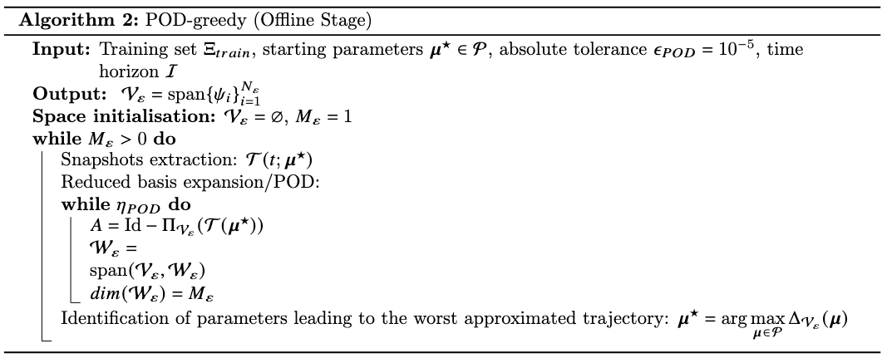

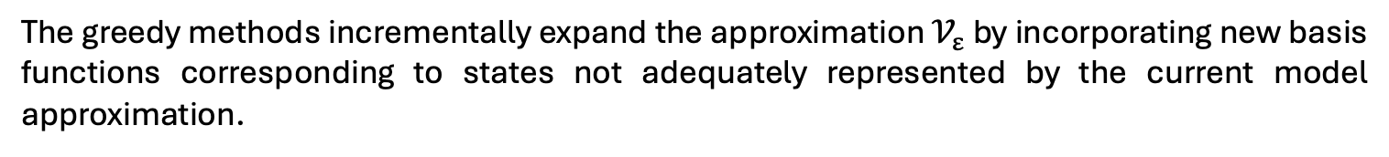
POD-greedy
The greedy methods incrementally expand the approximation $𝒱_{ε}$ by incorporating new basis functions corresponding to states not adequately represented by the current model approximation.
$$N_{ε}=58$$

Slide 9

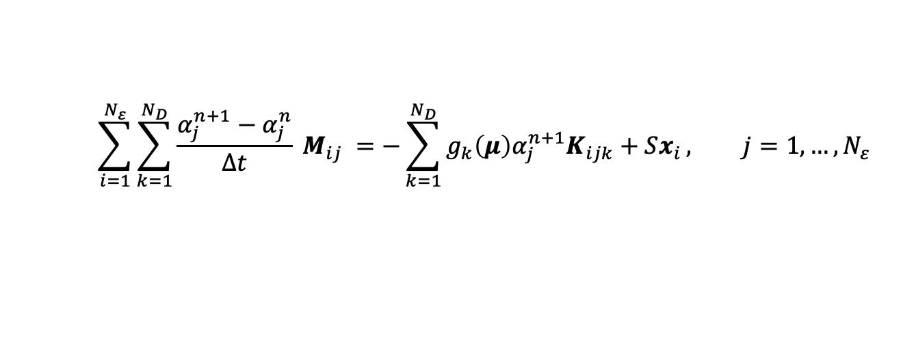
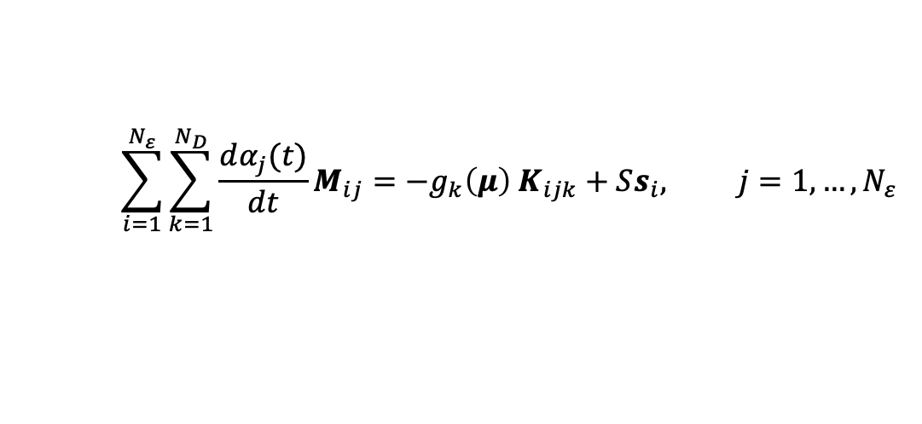
Online stage in SCIANTIX 2.1
$$\sum_{i=1}^{N_{ε}}{\sum_{k=1}^{N_{D}}{\frac{dα_{j}(t)}{dt}M_{ij}}}=−g_{k}\left(μ\right) K_{ijk}+Ss_{i}, j=1, …, N_{ε}$$
Backward Euler scheme:
$$\sum_{i=1}^{N_{ε}}{\sum_{k=1}^{N_{D}}{\frac{α_{j}^{n+1}−α_{j}^{n}}{Δt} M_{ij}}} =−\sum_{k=1}^{N_{D}}{g_{k}\left(μ\right)α_{j}^{n+1}K_{ijk}+Sx_{i}}, j=1, …, N_{ε}$$
Sciantix received as input a single file containing these matrices.

Slide 10
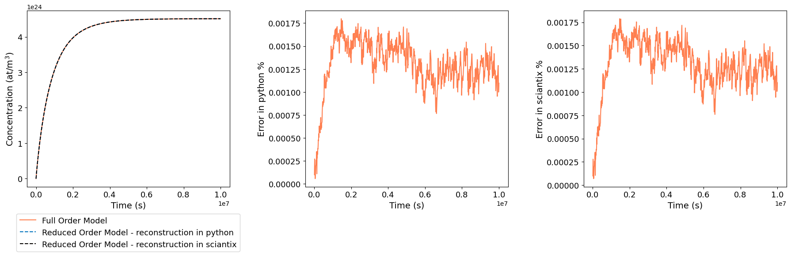
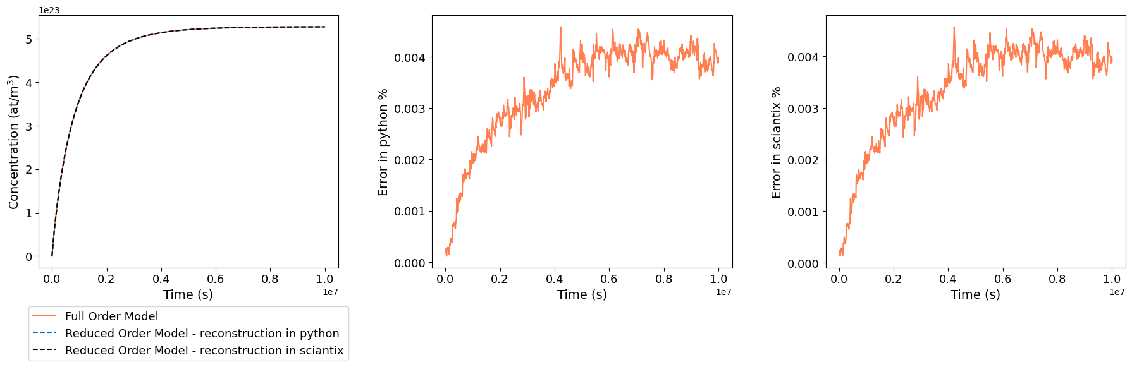




Online stage in SCIANTIX 2.1: comparison with FOM
Check done with reference case:
Maximum error = ${\text{1.8}\text{x}\text{10}}^{−3}$ %
Maximum error = ${\text{1.8}\text{x}\text{10}}^{−3}$ %
Check done with worst reconstructed parameters case:
Maximum error = ${\text{4.6}\text{x}\text{10}}^{−3}$ %
Maximum error = ${\text{4.6}\text{x}\text{10}}^{−3}$ %

Slide 11
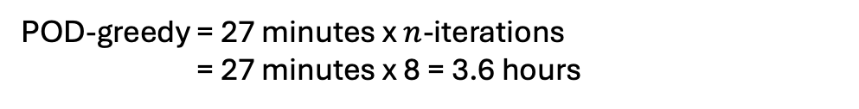
Computational times
Offline phase:
FreeFEM: 3 minutes
Full order: 7 minutes
POD: 20 minutes
= 3.6 ore
POD-greedy = 27 minutes x $n$-iterations
= 27 minutes x 8 = 3.6 hours
Online phase in sciantix: 5 seconds
Speed-up: 2592

Slide 12
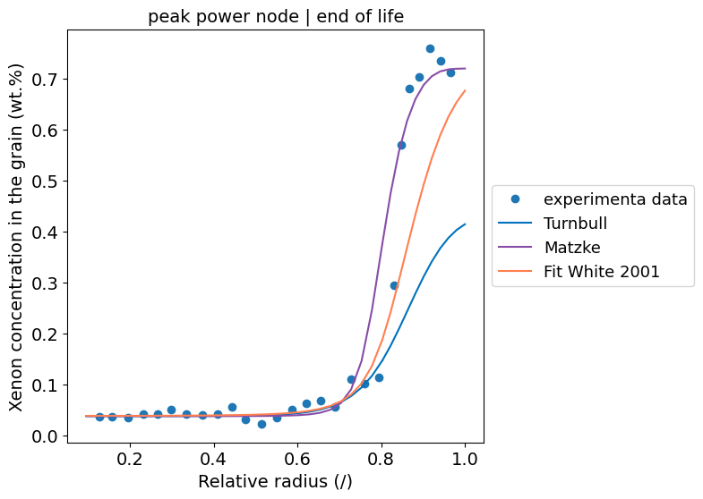
Diffusion coefficients

Slide 13
Next steps
Define the dedicated coupling interface between SCIANTIX and TRANSURANUS to account for columnar grains.
Apply the algorithm to integral irradiation cases:
SUPERFACT-1
SPHERE

Slide 14
Thank you for your kind attention

Slide 15
Literature
Forsberg, K., Massih, A.R., 1985. Fission gas release under time-varying conditions. Journal of Nuclear Materials 127, 141–145. doi:10.1016/0022-3115(85)90348-4.
Olander, D.R., 1976. Fundamental Aspects of Nuclear Reactor Fuel Elements, Technical Information Center – Energy Research and Development Administration, University of California, Berkeley, CA, USA.
Pastore, G., Swiler, L.P., ... Williamson, R.L., 2015. Uncertainty and sensitivity analysis of fission gas behavior in engineering-scale fuel modeling. Journal of Nuclear Materials 456, 398–408. doi:10.1016/j.jnucmat.2014.09.077.
Pastore, G., Pizzocri, D., Luzzi, L., 2018. An effective numerical algorithm for intra-granular fission gas release during non-equilibrium trapping and resolution. Journal of Nuclear Materials 509, 687–699. doi:10.1016/j.jnucmat.2018.07.030.
Pizzocri, D., Rabiti, C., Luzzi, L., Barani, T., Van Uffelen, P., & Pastore, G. 2016. PolyPole-1: An accurate numerical algorithm for intra-granular fission gas release. Journal of Nuclear Materials, 478, 333–342. https://doi.org/10.1016/j.jnucmat.2016.06.028.
Pizzocri, D., Di Gennaro, M., Barani, T., Silva, F. A. B., Zullo, G., Lorenzi, S., & Cammi, A. 2023. A reduced order model for fission gas diffusion in columnar grains. Nuclear Engineering and Technology, 55(11), 3983–3995. https://doi.org/10.1016/j.net.2023.07.013
Sirovich, L., 1987. Turbulence and the dynamics of coherent structures. I. Coherent structures. Quarterly of Applied Mathematics 45, 561–571. doi:10.1090/qam/910462.

Slide 16
Backup slides

Slide 17
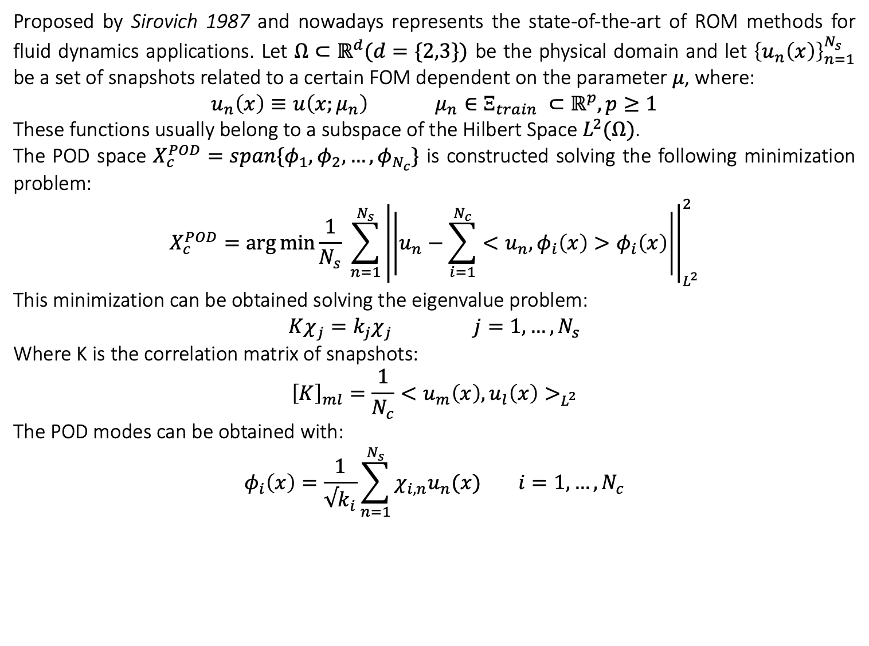
Proper Orthogonal Decomposition procedure
Proposed by Sirovich 1987 and nowadays represents the state-of-the-art of ROM methods for fluid dynamics applications. Let $Ω⊂ℝ^{d}(d=\{2,3\})$ be the physical domain and let ${\left\{u_{n}\left(x\right)\right\}}_{n=1}^{N_{s}}$ be a set of snapshots related to a certain FOM dependent on the parameter $μ$, where:
$$u_{n}\left(x\right)≡u\left(x;μ_{n}\right) μ_{n}∈Ξ_{train} ⊂ℝ^{p}, p≥1$$
These functions usually belong to a subspace of the Hilbert Space $L^{2}(Ω)$.
The POD space $X_{c}^{POD}=span\{φ_{1},φ_{2}, …,φ_{N_{c}}\}$ is constructed solving the following minimization problem:
$$X_{c}^{POD}=\arg{\min{\frac{1}{N_{s}} \sum_{n=1}^{N_{s}}{{\left|\left|u_{n}−\sum_{i=1}^{N_{c}}{<u_{n}, φ_{i}\left(x\right)>φ_{i}\left(x\right)}\right|\right|}_{L^{2}}^{2}}}}$$
This minimization can be obtained solving the eigenvalue problem:
$Kχ_{j}=k_{j}χ_{j} j=1,…, N_{s}$
Where K is the correlation matrix of snapshots:
$${\left[K\right]}_{ml}=\frac{1}{N_{c}}<u_{m}\left(x\right), u_{l}\left(x\right)>_{L^{2}}$$
The POD modes can be obtained with:
$$φ_{i}\left(x\right)=\frac{1}{√k_{i}}\sum_{n=1}^{N_{s}}{χ_{i,n}u_{n}(x)} i=1,…, N_{c}$$

Slide 18
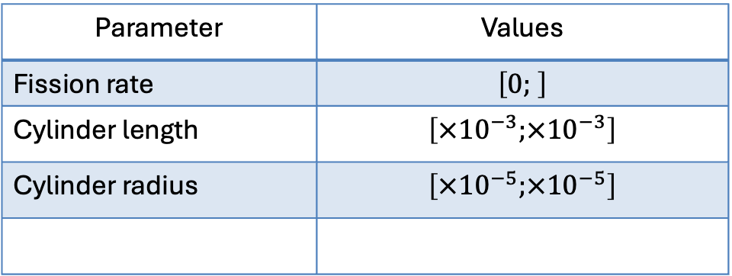
SUPERFACT
Parameter | Values
Fission rate | $$\left[0; \right]$$
Cylinder length | $$\left[×{10}^{−3};×{10}^{−3}\right]$$
Cylinder radius | $$\left[×{10}^{−5};×{10}^{−5}\right]$$

